Slide 1
Space, Range and Display
Production Server
Boot Up Sequence

Slide 2
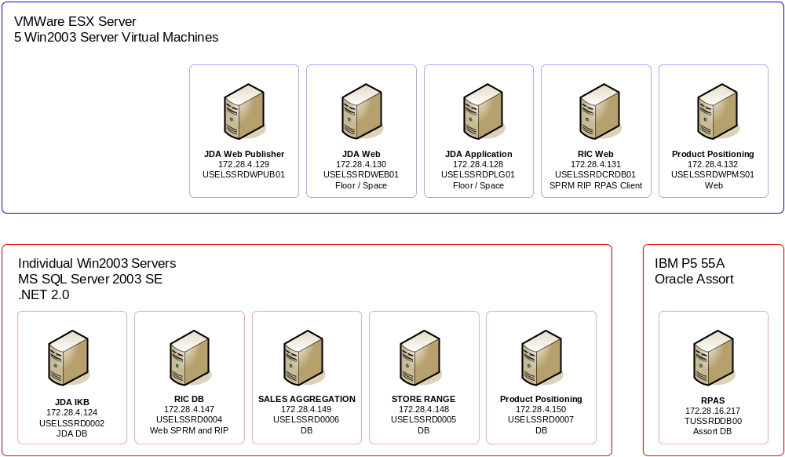
Production Environment

Slide 3
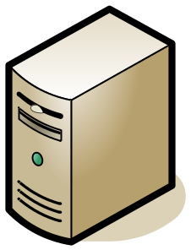
SRD Server Boot Up Sequence
Database Servers
  JDA IKB – SQL 2005
  CRDB (RIC) – SQL 2005
  Sales Aggregation – SQL 2005
  Product Positioning – SQL 2005
  Store Range – SQL 2005
  Oracle RPAS – Oracle
Application Servers
  JDA Application
  JDA Web Publisher
  JDA Web Portal
  Range In Controls
  Product Positioning

Slide 4
SRD Server Boot Up Sequence
Booting up the SRD Production servers depends on the criticality and who the target audience will be. By default the following should be booted in sequence:
  Stores
    Access Planograms and Floorplans
    2000+ Store Employees
  Main Office
    Create Events, Planograms and Floorplans
    4+ Users
  Downstream Systems
    Data sent downstream to other systems
    GO Systems and Storeline Systems

Slide 5
SRD Server Boot Up Sequence
Stores:
Require access to Planograms and Floorplans
Servers:
    JDA IKB Server and SQL Database
      172.28.4.124 | USELSSRD002
      Services: SQL Server
      DB: IKB
    JDA Web Portal Web Server
      172.28.4.129 | USELSSRDWEB01
      Services: IIS
    JDA Server Application Server
      172.28.4.128 | USELSSRDPLG01
      Apps: IKB Data Manager, JDA Floor Planning, JDA Space Planning
    JDA Server and Web Publisher
      172.28.4.129 | USLELSSRDWPUB01
      Services: IIS, Batch Processor Agent, Batch Processor Allocator, Batch Process Monitor

Slide 6
SRD Server Boot Up Sequence
Main Office:
Require to create Planning Events, Ranging Events and Ranging products to stores
Servers:
    CRDB Server and Database
      172.28.4.147 | USELSSRD004
      Services: SQL Server
      DB: CRDB
    Range in Control App Server
      172.28.4.131 | USELSSRDCRDB01
      Services: IIS
    Oracle RPAS
      172.28.16.217 | TUSSRDDB00
      DB: XXXX
      Version

Slide 7
SRD Server Boot Up Sequence
Downstream Systems:
Require data flow to be sent to Storeline and GO
Servers:
    Store Range Server and Database
      172.28.4.148 | USELSSRD005
      DB: Store Range
      Services: SQL Server
    Sales Aggregation Server and Database
      172.28.4.149 | USELSSRD006
      DB: Sales Aggregation
      Services: SQL Server
    Product Positioning Server and Database
      172.28.4.150 | USELSSRD007
      DB: Product Positioning
      Services: SQL Server
    Product Positioning Application Server
      172.28.4.132 | USELSSRDWPMS01
      DB:
      Services: IIS

Slide 8
Production Environment
4
2
3
6
11
1
5
9
8
10
7

